Slide 1

The Data Immersed (TDI) Loan Data Analysis
NAME : BLESSING OLADIMEJI
27th September, 2024.

Slide 2
Loan Metrics: Performance and Risk Analysis
This project presents an in-depth analysis of loan performance, risk factors, and borrower profiles to optimize lending strategies and monitor loan issuance for TDI.

Slide 3
Project Overview
Objective : Addressing key challenges faced by TDI, including high default rates, understanding borrower risk profiles, optimizing interest rates, and improving loan performance tracking.
Key Focus Areas :
Identifying default risks using borrower demographic data.
Analyzing relationships between debt-to-income (DTI), loan-to-income (LTI), and loan performance.
Monitoring loan issuance trends and approval rates to better understand regional loan distribution.

Slide 4
Data Cleaning and Preparation
Data Cleaning:
Handled missing values in key columns like emp_title, filled missing loan_amount values with averages, and formatted columns (e.g., annual_income as currency, dti as a percentage).
Data Transformation:
Renamed columns (e.g., home_ownership, verification_status) for clarity.
Split date fields into useful components (e.g., issue_date, last_payment_date).
Grouped employment lengths and created income and interest rate brackets for better analysis.

Slide 5
Calculated Fields and Metrics
Monthly Debt Payment :
Formula: =ABS(PMT(Interest Rate, Term_Length in months, Loan_Amount))
Debt-to-Income (DTI):
Formula: monthly debt payment / loan amount * 100
Loan-to-Income (LTI):
Formula: loan amount / annual income * 100
Default Rate :
Formula: SUM(Default loan) / TOTAL LOANS
Income Brackets :
Grouped into low income (<$50,000) to high income (>$1M).

Slide 6
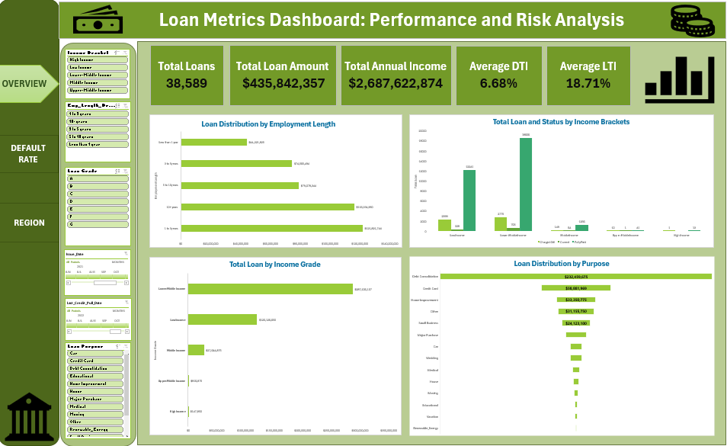
Loan Metrics Dashboard
The dashboard consolidates various metrics and charts to provide insights into loan issuance, borrower demographics, and risk factors. It allows for tracking loan distribution, default rates, and approval patterns across regions and borrower profiles.

Slide 7
Key Insights from Loan Performance
Total Loan Distribution: Loans are concentrated among middle-income and lower-middle-income brackets, with higher default rates in the lower-income group.
Employment Length Impact: Borrowers with longer employment histories tend to have lower default rates.
Grade Analysis: Loan approval rates increase with better borrower grades, but higher-risk grades contribute significantly to defaults.

Slide 8

Loan Default Rate and Risk Profiles
Default Rate by Income Grade: Higher default rates are observed in low-income brackets and among borrowers with shorter employment lengths.
Influence of DTI and LTI: Higher debt-to-income (DTI) ratios correspond to an increased likelihood of default, with interest rates also playing a significant role.

Slide 9

Loan Distribution by Purpose
Funnel Visualization: Loans for debt consolidation make up the largest share, followed by loans for home improvement and medical expenses.
Analysis: Borrowers are using loans primarily for consolidating existing debt, which indicates potential financial stress.
This Photo by Unknown Author is licensed under CC BY

Slide 10
Loan Issuance and Default Over Time
Loan Issuance Growth:
Loan issuance has grown steadily over time, with defaults rising in parallel.
Analysis:
The upward trend in default rates suggests a need to reevaluate borrower risk assessments, especially for higher loan amounts and riskier grades.

Slide 11
Loan Approval and Default Rates Across U.S. States
Map Visualization: Approval rates vary across regions, with states like California and Texas showing higher approval rates, while others like Louisiana and Alabama have lower rates.
Insight: Geographic differences in loan approval rates reflect varying economic conditions and risk profiles, suggesting region-specific lending strategies.

Slide 12
Key Performance Indicators (KPIs)
Total Loans: 38,589
Total Loan Amount: $435,842,357
Total Annual Income: $2,687,622,874
Average DTI: 6.68%
Average LTI: 18.71%
These KPIs highlight the scale of the loan portfolio and the overall health of the borrower base.

Slide 13
Conclusion and Next Steps
Conclusion:
The analysis revealed significant insights into borrower risk profiles, loan performance, and default patterns.
Recommendations:
Introduce stricter loan eligibility criteria for high-risk borrowers.
Optimize interest rates based on borrower risk to minimize default rates.
Implement region-specific strategies to manage loan issuance across states.

